Slide 1
Analysis of Housing Datasets
Project Workflow
Data Cleaning and Preprocessing
Exploratory Data Analysis (EDA)
Visualization
Feature Engineering
Analysis and Interpretation
Presented by: Manjula M
Data Analytics
Milestone – 1 (Python Data Exploration Project)
Date: June 9, 2024

Slide 2
Introduction
Data Understanding :
Project Objectives :
Identify structure and types
Analyze housing market data
Formulate hypotheses
Identify key factors influencing prices
contextual insight
Provide actionable insights
Data Preprocessing :
Handle missing values
Dataset Overview :
Address inconsistencies
Attributes : price, square footage, bedrooms , bathrooms , location
Encode categorical variables
Data visualization:
Identify patterns and trends
Detect outliers
Communicate insights

Slide 3
Data Understanding
Overview of the Dataset Structure:
Number of rows and columns
Data types for each column
Summary Statistics for Numerical Features:
Mean, median, min, max

Slide 4
Insights from Initial Exploration
Key points:
Notable patterns
Patterns: Seasonal trends, geographic patterns
Outliers: Extremely high or low values
Missing Values: Gaps in data entries
Outliers
Missing values

Slide 5
Missing Values Handling
(4600, 18)
Techniques Used to Detect Missing Values:
Techniques Used to Handle Missing Values:
Shape of the Dataset:
Summary statistics and visualizations
Null value checks
Imputation
(mean/median/mode)
Selection of relevant columns
Shape = (4600, 18)

Slide 6
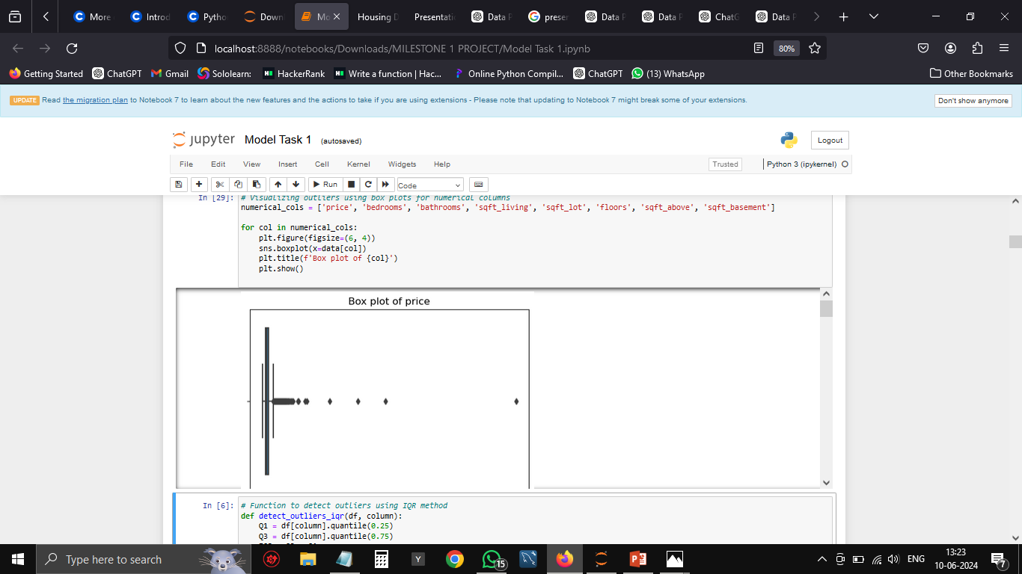
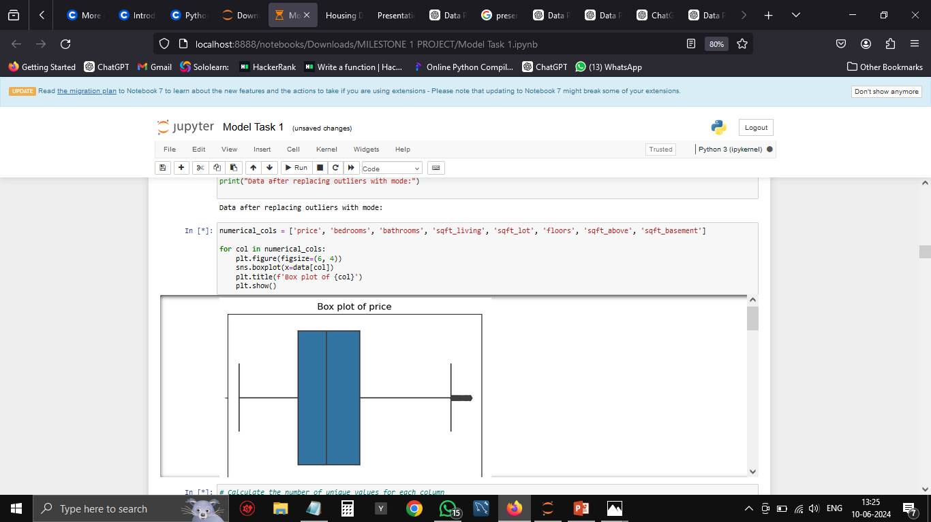
Outlier Handling
Strategies for Identifying and Handling Outliers:
Identification: IQR method
Handling: Replace with mode
Box Plots to Visualize Outliers in Numerical Features:
Visualizations: Box plots
Explanation of Outlier Removal Techniques and Impact on the Dataset:
Technique: Mode replacement
Impact: Improved data quality

Slide 7
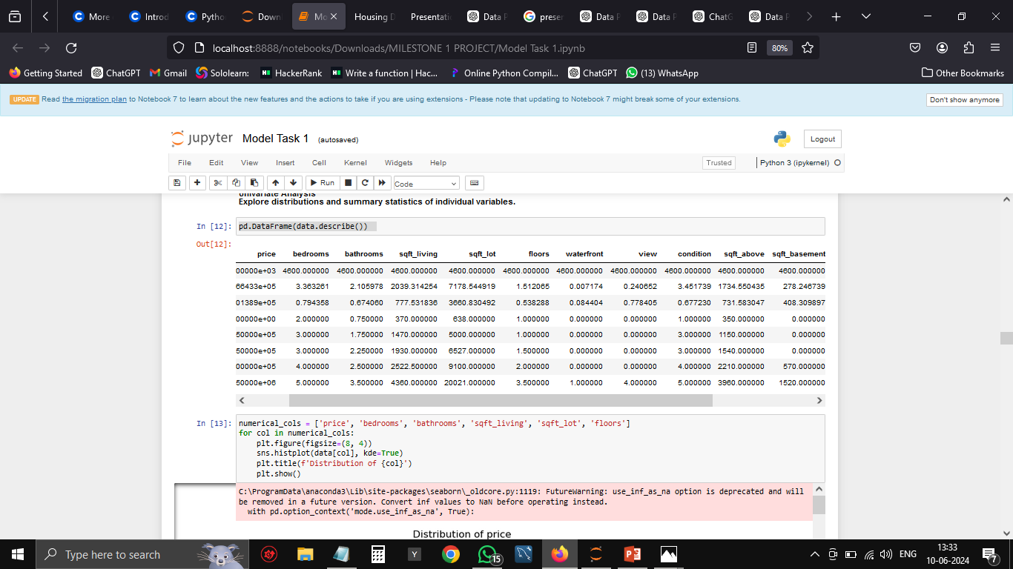
Fixing Rows and Columns
Output :
Details of Fixing Rows and Columns :
Selected relevant columns
Ensured data consistency
Before-and-After Comparison: Shape of the Dataset:
Before: Original shape – (4600,18)
After: Refined shape - (4600, 15)

Slide 8
Handling Invalid Values
Identification of Invalid or Erroneous Entries:
Techniques Used to Correct or Remove Invalid Values:
Examples of Specific Invalid Values Encountered and How They Were Addressed:
Techniques: Summary statistics
Examples: Negative values for price or square footage domain knowledge
Correction: Replacing with plausible values or mean/mode
Removal: Deleting entries if correction is not possible Mean/mode
Example: Negative price values replaced with mean price
Example: Erroneous square footage entries corrected or removed

Slide 9
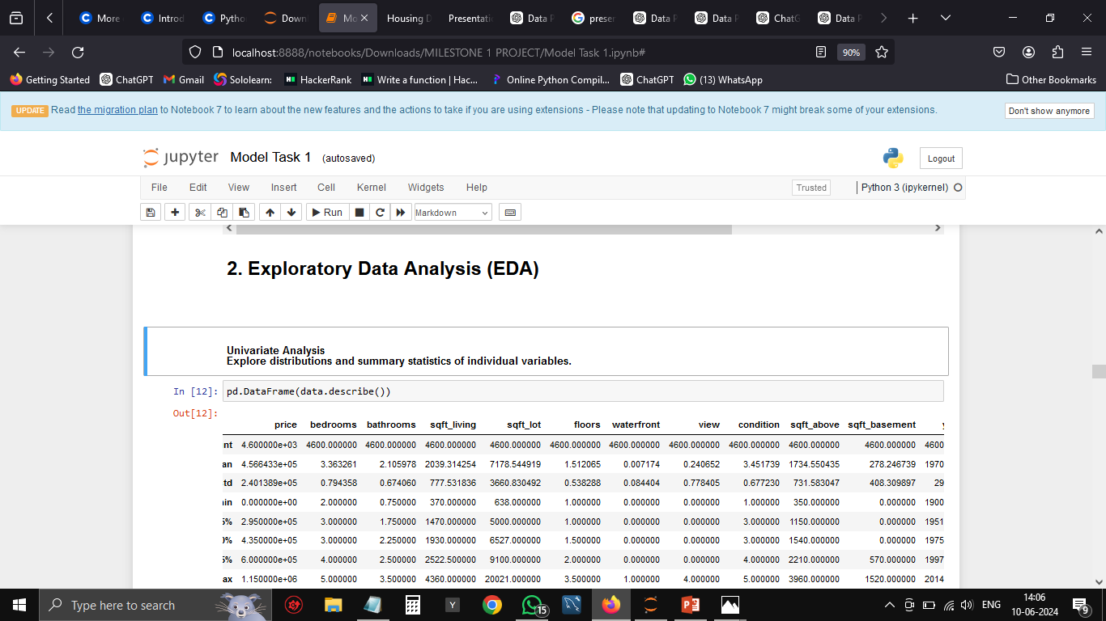
Data Visualization (EDA)
Techniques: Univariate, bivariate, and multivariate analysis
Overview of EDA techniques used

Slide 10
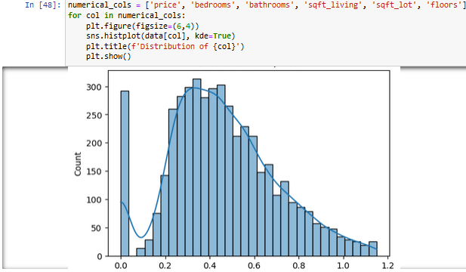
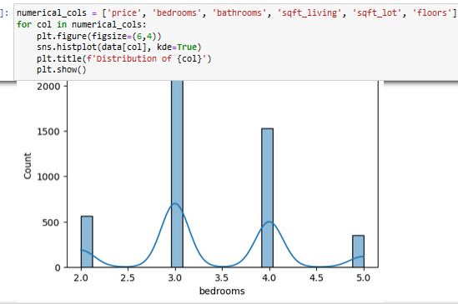
Univariate Analysis - Distribution of Price
Visualization: Histogram of price
Visualization: Histogram of bedrooms

Slide 11
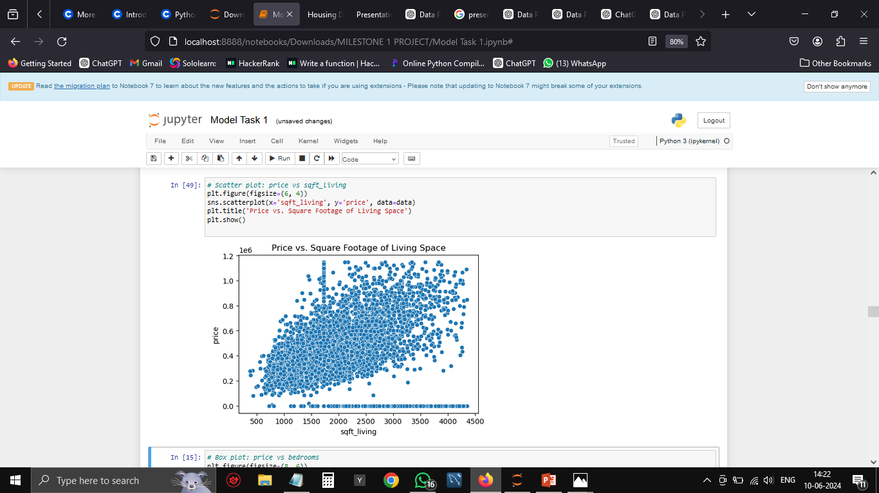
Bivariate Analysis
Visualization:
Visualization: Scatter plot of price vs. square footage

Slide 12
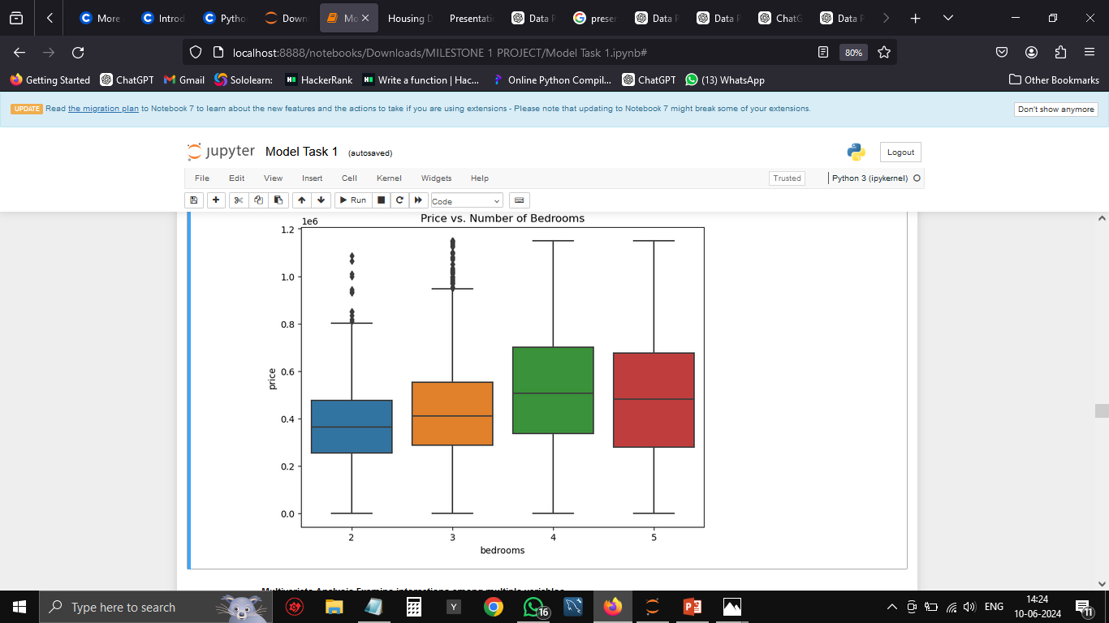
Bivariate Analysis - Price vs. Number of Bedrooms
Visualization:

Slide 13
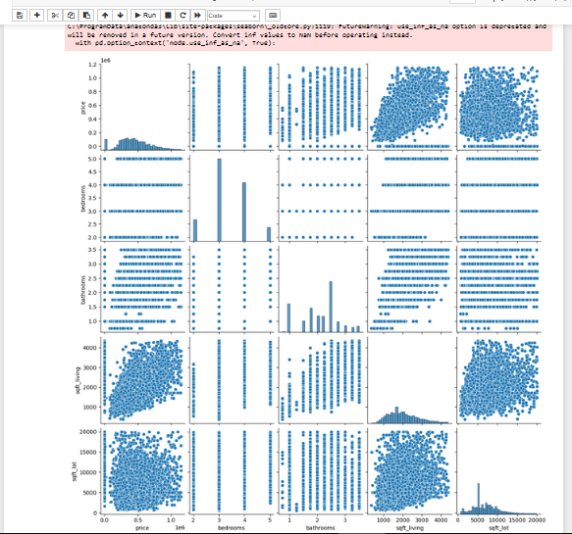
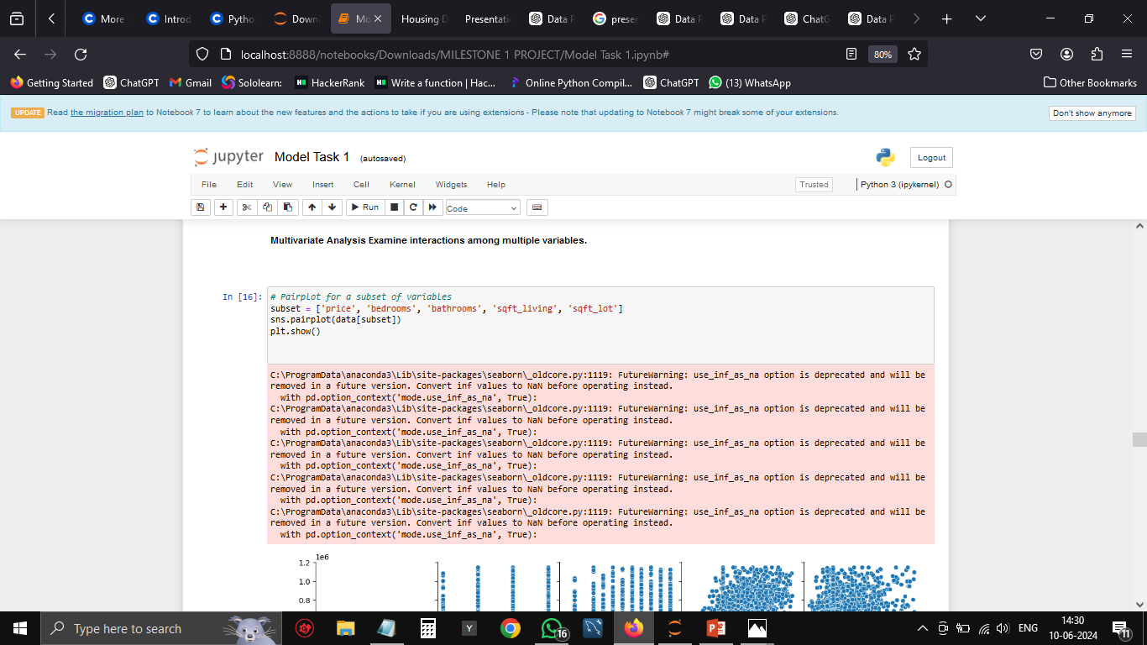
Multivariate Analysis
Visualization: Pair plot for selected features

Slide 14
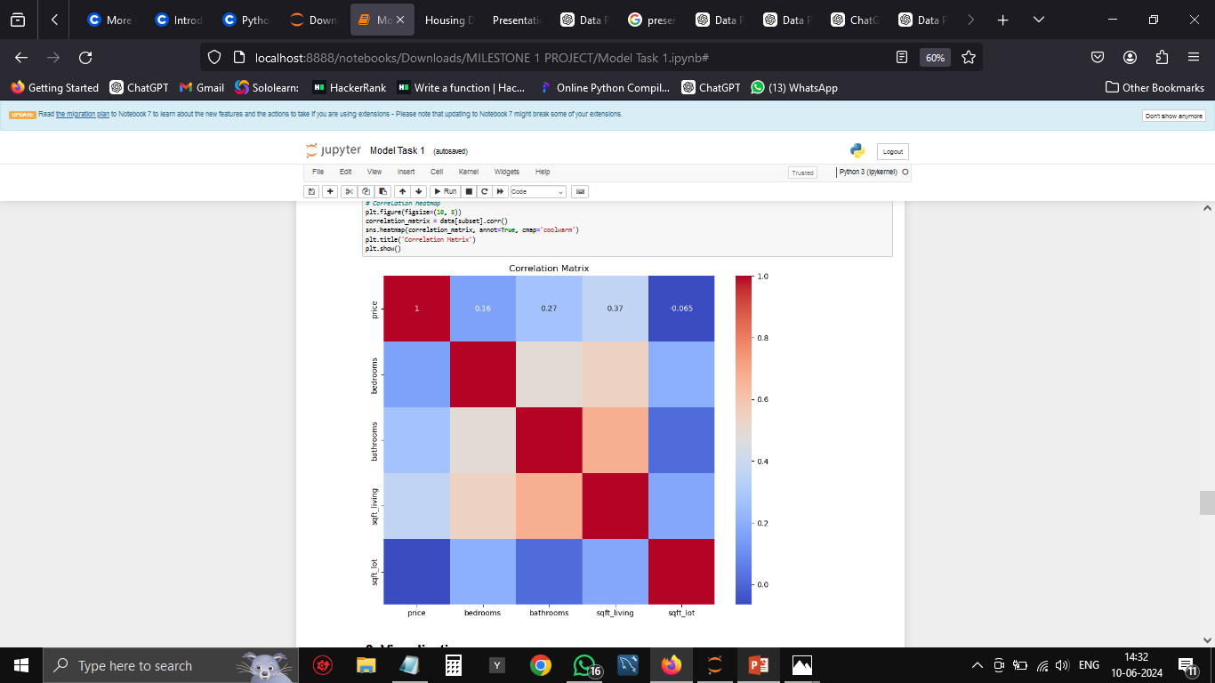
Multivariate Analysis
Visualization: Heatmap of correlation matrix

Slide 15
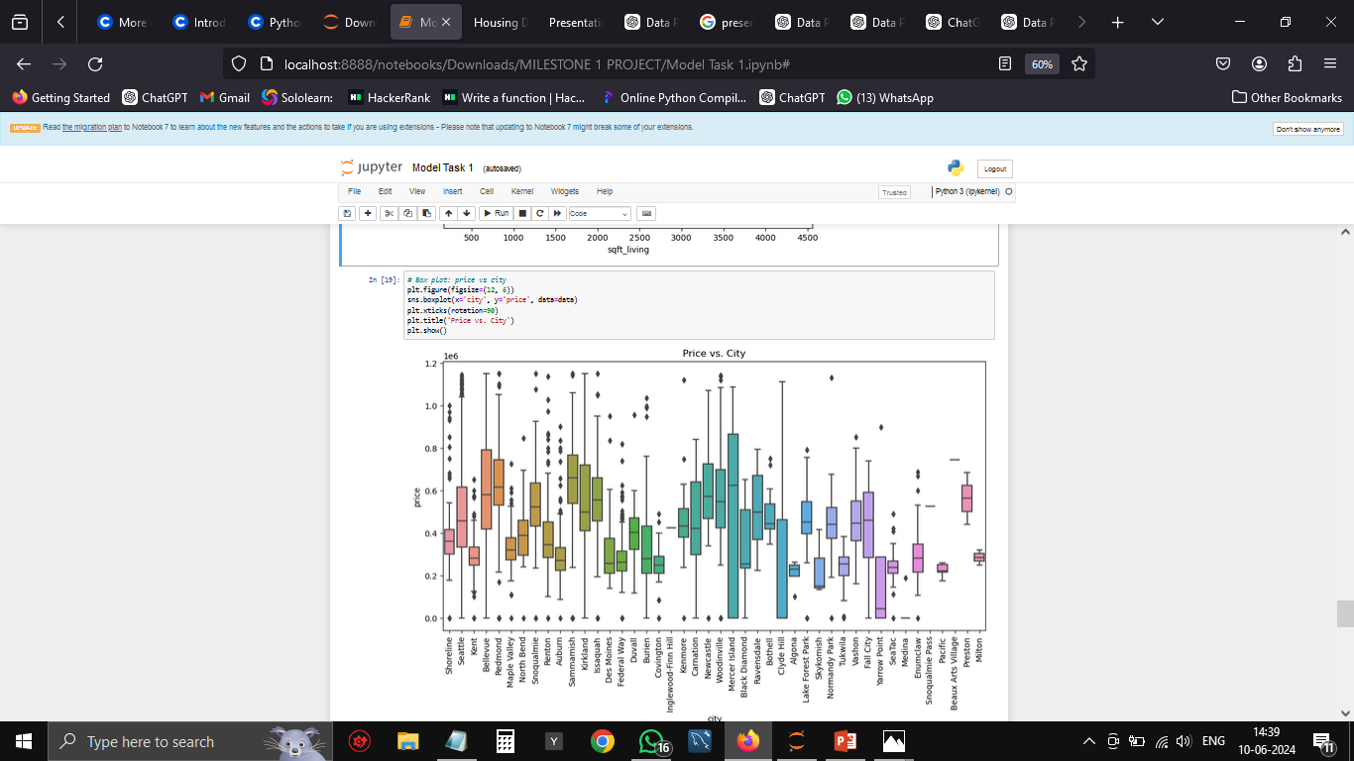
Data Visualization
Visualization: Box plot of price vs. city

Slide 16
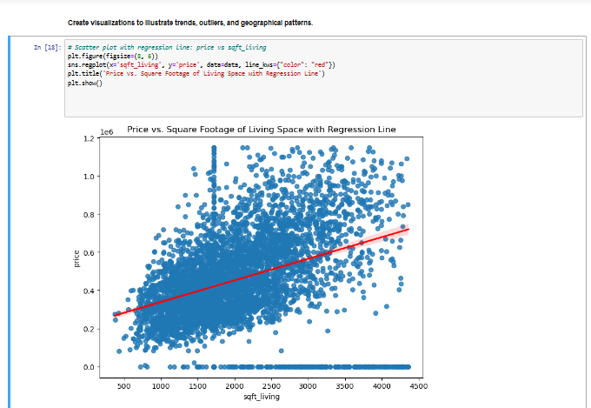
Visualization - Scatter Plot with Regression Line
Visualization:

Slide 17
Summary and insights
Price Trends: Larger homes with more bedrooms and bathrooms tend to have higher prices.
Location Impact: House prices vary significantly by city, with certain locations commanding premium prices.
Feature Importance: Square footage and the number of bedrooms are strong predictors of house prices.
Derived Metrics: Age of the property and price per square foot provide valuable insights into property value.

Slide 18
Thank You
By – Manjula. M

